Slide 1
Clonfert Diocese’s Children’s Art Competition 2023

Slide 2
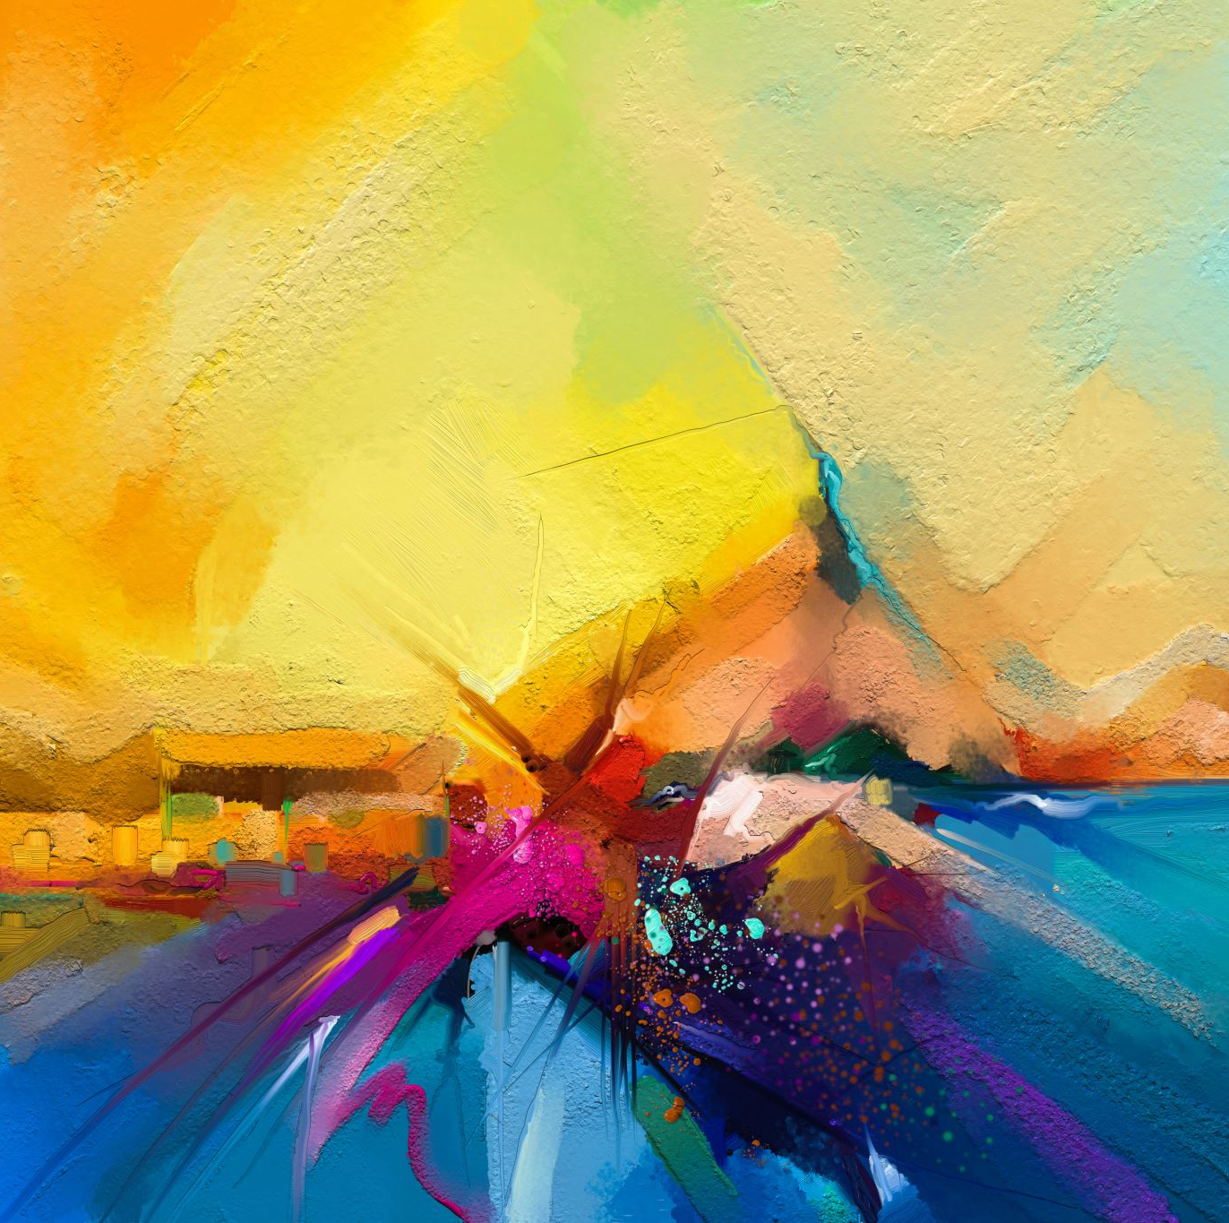
Introduction
If you are in 3rd, 4th, 5th or 6th class we would love for you to enter our 2023 Art Competition.
Our competition will run from Monday 27th^{th} March to Friday 26th May 2023.

Slide 3
Choice of Subjects (5th & 6th Class)
Mary of Magdala meets Jesus (John 20:11-17)
The Holy Spirit comes to the disciples (Acts 2:1-4)
My favourite saint from the bible (Old Testament characters can be included)
Jesus calms the storm (Mark 5:35-39)

Slide 4
Choice of Subjects (3rd & 4th Class)
Mary visits her cousin Elizabeth (Luke 2:39-45)
A scene from my favourite bible story
Zacchaeus meets Jesus (Luke 19:1-10)
Jesus ascends into heaven (Luke 24:50-53)

Slide 5
Categories)
Our competition is divided into four categories:
Categories A & B : Children in 5th and 6th Class
Categories C & D : Children in 3rd and 4th Class

Slide 6
Sponsors
We would like to thank Ballinasloe Credit Union, Garbally View Nursing Home, Gullane’s Hotel, Hubert Dolan Electrical, Salmon’s Department Store, and St. Grellan’s (Ballinasloe & District) Council of The Knights of St. Columbanus, for sponsoring this competition.

Slide 7
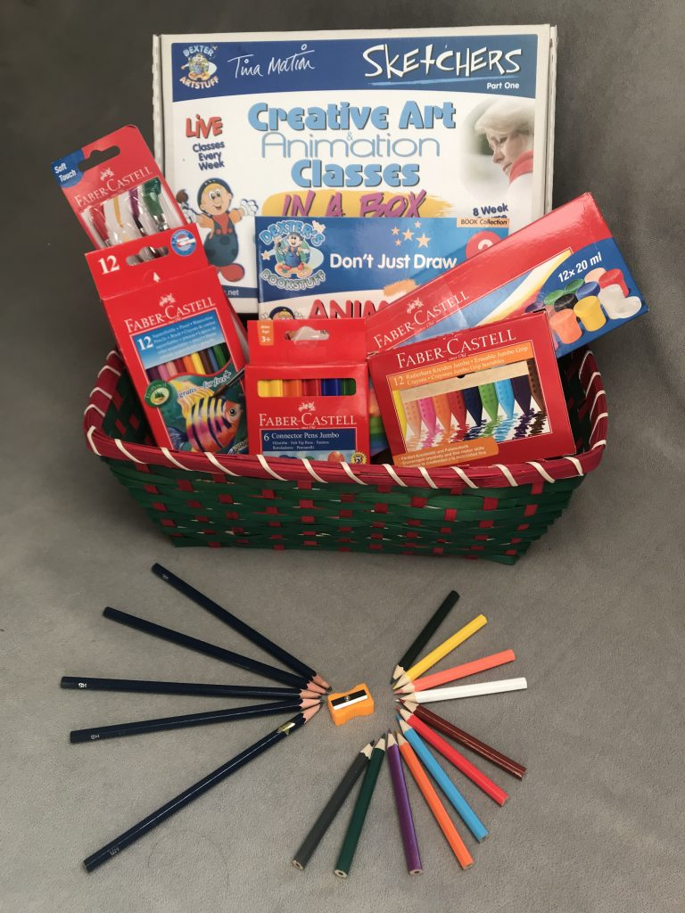
Prizes (All Categories)
First prize- €50 Art Hamper Voucher & Winner’s Certificate
Second prize- €35 Art Hamper Voucher & Runner’s Up Certificate
Third prize-€25 Art Hamper Voucher & Runner’s Up Certificate Best entry from each participating school will be awarded a special certificate. First, Second and Third Prize winners will also win ↗ a Children’s Bible for their classroom.

Slide 8
Terms & Conditions
You will find these and other useful information at: www.creideamh.ie/clonfert-art
* Important Tip *
The Judges are very interested in how you see Jesus.

Slide 9
Entry Form
Entry Forms can be downloaded at: www.creideamh.ie/clonfert-art
Only entries accompanied by an Entry Form will be accepted.

Slide 10
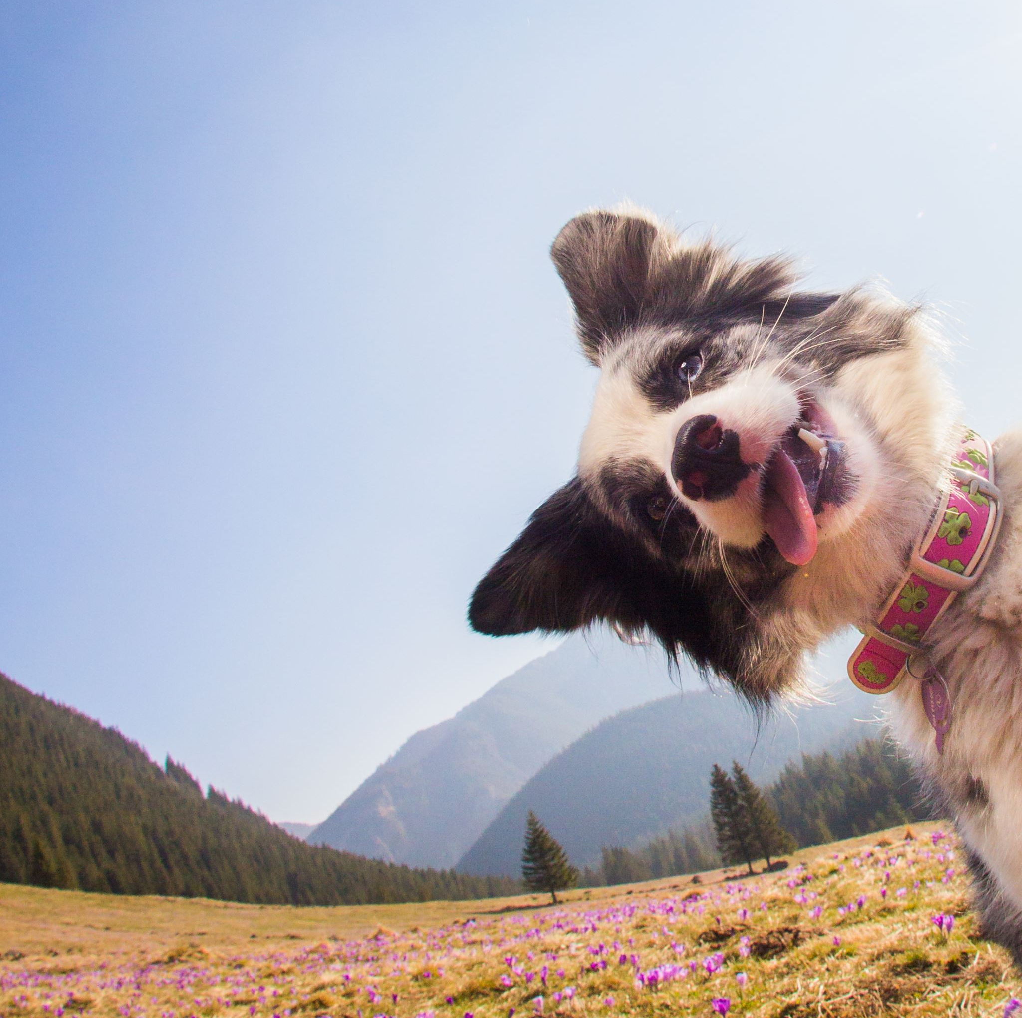
One More Thing!
Enjoy and have fun!!!

